Slide 1

写
博
客
是
王
道

Slide 2







1st Post
14
Jekyll @ Github
Hexo
395 Posts
2012.4
2013.8
2014.3
2014.10
2014

Slide 3

知
识
结
构
化

Slide 5
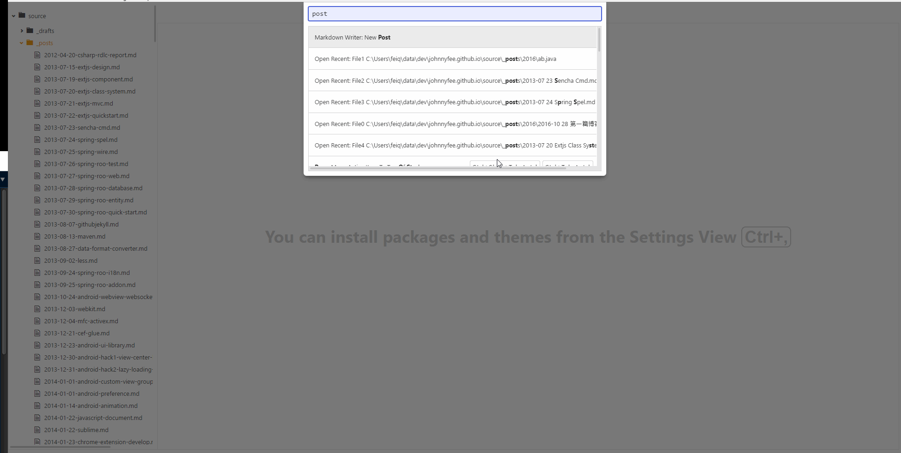
像写 Code 一样去写文章

Slide 6
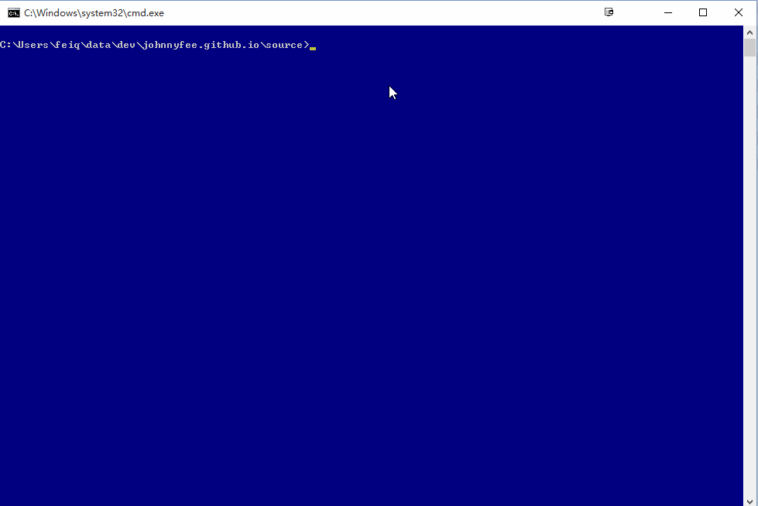
Push to Github

Slide 7
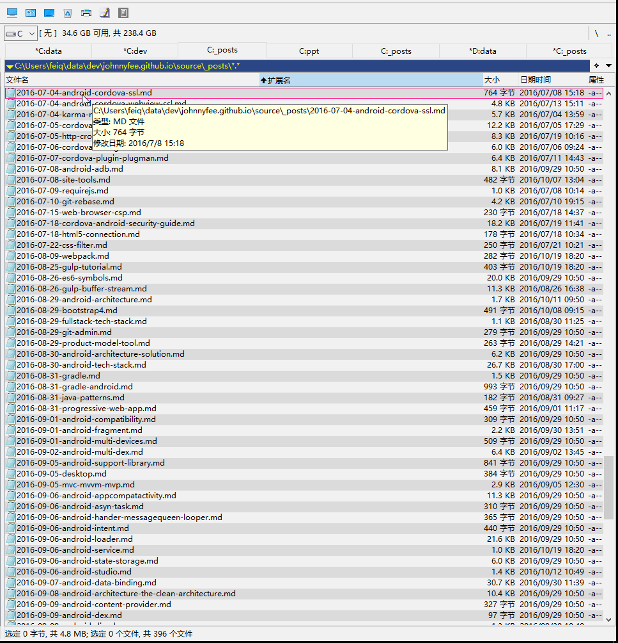
Once count(文章) > 400+
Then TotalCommand in Windows
Terminal in Mac
Atom in Windows/Mac

Slide 8
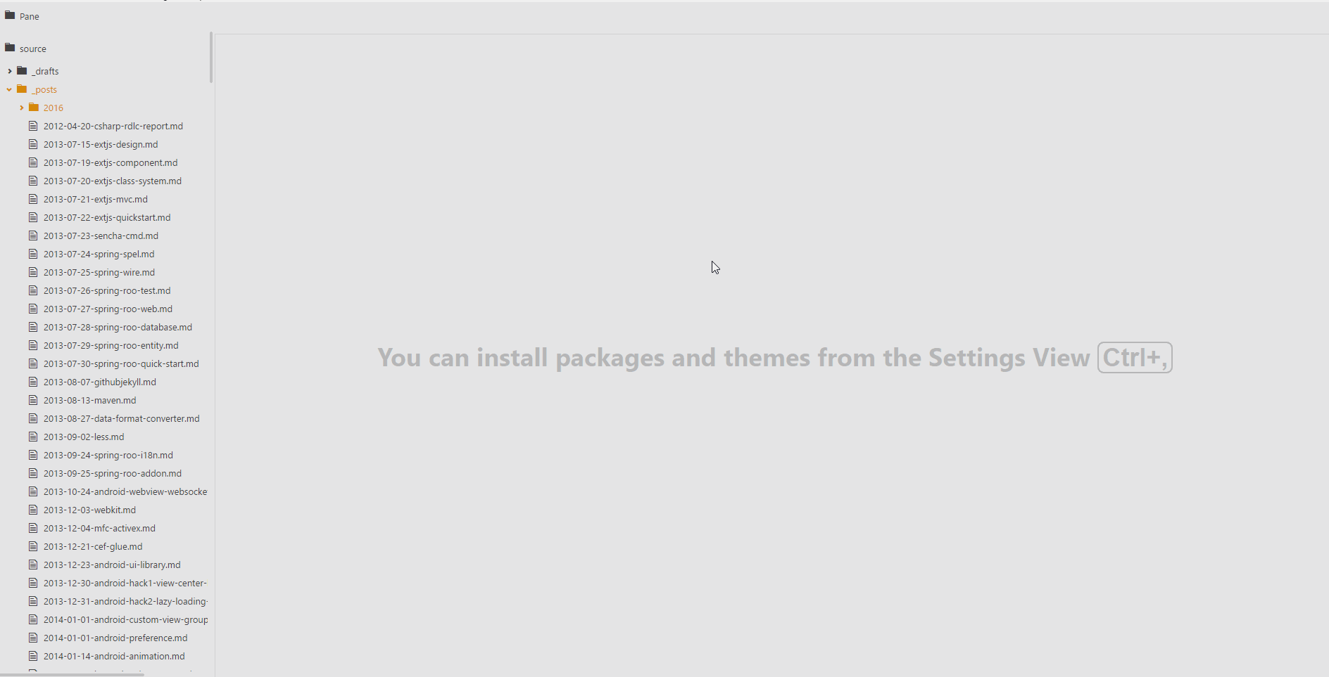
像编码一样
对自己也要记住两个字，“节操”

Slide 9
如何从网络上拷贝文章

Slide 10

Then how to build the blog
https://hexo.io/
$ npm install hexo-cli -g
$ hexo init blog
$ cd blog
$ npm install
$ hexo server

Slide 11


Thank you
https://github.com/JohnnyFee
https://github.com/inchingorg
http://blog.inching.org/

